Slide 1
Passerelles numériques
A Gateway for Life
Advanced Query

Slide 2
Outline
UNION and UNION ALL
EXCEPT and INTERSECT
Sub-queries
Inner Joins
Outer Joins

Slide 3
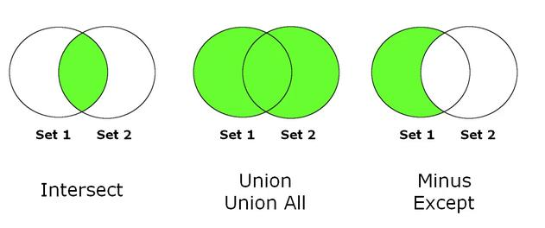
1. UNION and UNION ALL
What is a union of tables?
is an operator used to combine two or more result set from multiple tables to a single result set.
Look at the figure below:

Slide 4
1. UNION and UNION ALL
The syntax of UNION in MySQL is:
SELECT query1
UNION [DISTINCT | ALL]
SELECT query2
UNION [DISTINCT | ALL]
SELECT query3
UNION [DISTINCT | ALL]
……………………………
For select query, you can use all clauses. It also can contain row functions, joins and group summarization.

Slide 5
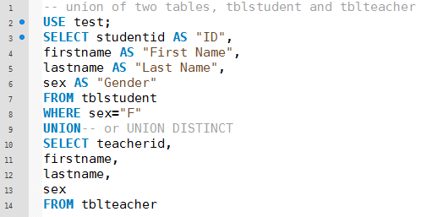
1. UNION and UNION ALL
Consider the following example:
Notes:
use database “test” to show the student. This database contains all tables and data used in this example.

Slide 6
1. UNION and UNION ALL
The rule of a UNION:
The column name of the first SELECT used as the column name of the returned result set.
The number and the data type of the selected column must be the same.
No new columns are added in a UNION.
The maximum number of rows is the sum of selected rows.
You can use ORDER BY clause at the end of the statement sort the returned result set.

Slide 7
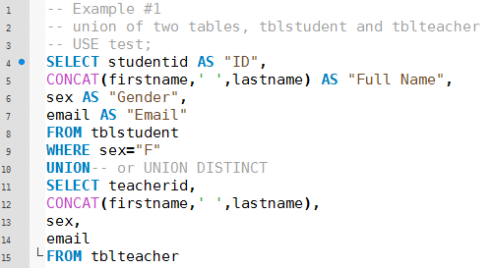
1. UNION and UNION ALL
Notes:
use database “test” to show the student. This database contains all tables and data used in this example.

Slide 8
1. UNION and UNION ALL
What is the difference between union and union all?
UNION or UNION DISTINCT not allow duplicate rows.
UNION ALL allows duplicate rows.
UNION ALL can run faster than UNION because it requires less resources than UNION DISTINCT.
The rules that are applied to UNION also applied to UNION ALL as well.

Slide 9
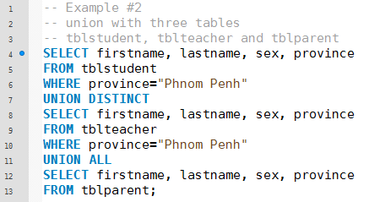
1. UNION and UNION ALL
Notes:
use database “test” to show the student. This database contains all tables and data used in this example.

Slide 10
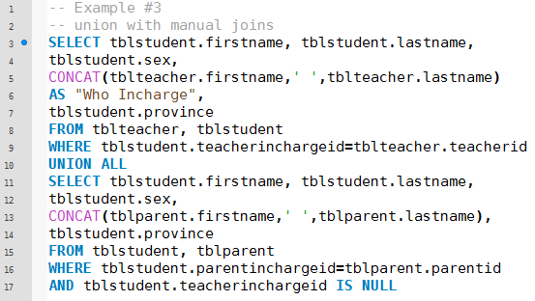
1. UNION and UNION ALL
Notes:
use database “test” to show the student. This database contains all tables and data used in this example.

Slide 11
Example
we want to list the three oldest and three newest employee from the employee table

Slide 12
Except And Intersect

Slide 13
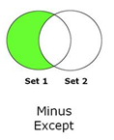
2. EXCEPT and INTERSECT
What is EXCEPT?
Is an operator used to combine two select statements and returns rows from the first statement that are not exist in the second statement.

Slide 14
It’s not available in MySQL.
In MySQL, you have to used NOT IN or NOT EXISTS or OUTER JOIN instead.
Just like UNION operator, the same rules must be applied when using EXCEPT operator.

Slide 15
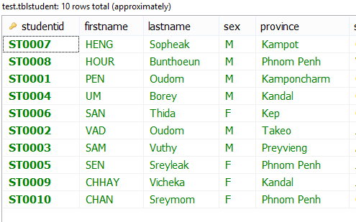
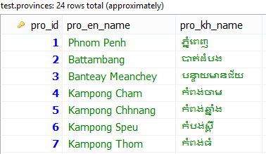

Example: EXCEPT
Use test DB model to view student have province name difference from tblprovinces
tblprovinces
tblstudent

Slide 16

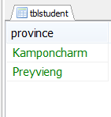

Solution
With NOT IN
With NOT EXISTS

Slide 17
Activity:30mn
Get all students who come from the province name which doesn’t start with letter P.
Write query to get all provinces which don’t have any students
Show list of students from province “ភ្នំពេញ”
List down student under responsible of teacher have last name is “Vongkol”
Notes:
In and not in (exits and not exists)
#exercise:
#1 SELECT studentid,firstname,lastname,province FROM tblstudent WHERE province not in (SELECT pro_en_name FROM tblprovinces WHERE pro_en_name LIKE 'p%');
#2 select * from tblprovinces pro where pro.pro_en_name not in (select DISTINCT(stu.province) from tblstudent stu);
#3 select * from tblstudent where province in (select pro_en_name from tblprovinces pro where pro.pro_kh_name ="ភ្នំពេញ");
#4 select * from tblstudent stu where stu.teacherinchargeid in (select tea.teacherid from tblteacher tea where tea.lastname ="Vongkol");

Slide 18
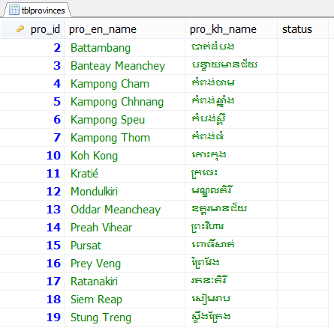
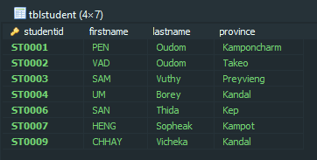
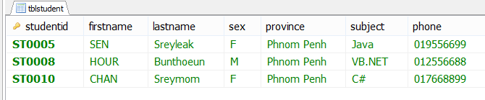
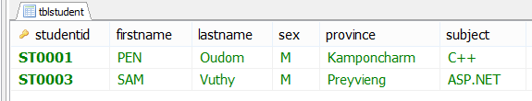
A2
A1
A3
A4

Slide 19
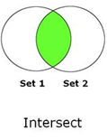
Intersect
What is INTERSECT?
is an operator used to combine two selects statement, but returns only rows from the first select statement that are identical to a row in the second select statement.

Slide 20
Intersect
It returns the common rows between the two select statements.
This operator is not available in MySQL.
We can use INNER JOIN or IN to form INTERSECT in MySQL.

Slide 21
Use test DB model to view student have province name the same in tblprovinces table
tblprovinces
tblstudent

Slide 22
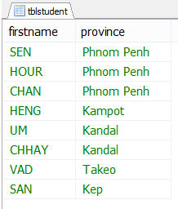
Solution
With “IN”
With “INNER JOIN”
Result

Slide 23
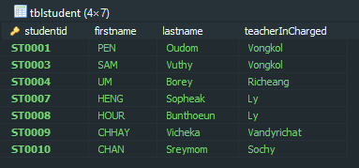
Activity:10mn
List down all students who have in charged teacher
Notes:
SELECT studentid,firstname,lastname,
(SELECT tblteacher.lastname FROM tblteacher WHERE tblteacher.teacherid=tblstudent.teacherinchargeid) AS teacherInCharged
FROM tblstudent WHERE teacherinchargeid IN (SELECT teacherid FROM tblteacher);

Slide 24
3. Subqueries
What is a subquery?
Is a SELECT statement within another statement.
Sometimes called
inner query or nested query
inner select or nested select

Slide 25
Subqueries
It’s often used with the following statements along with comparison operators:
SELECT
INSERT
UPDATE
DELETE

Slide 26
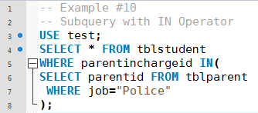
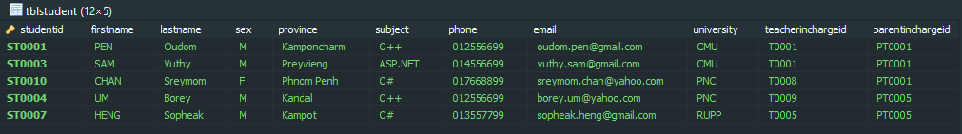
3. Subqueries
Get all students whose parent are Police
Notes:
SELECT * FROM tblstudent WHERE parentinchargeid IN
(SELECT parentid FROM tblparent WHERE job='Police');

Slide 27
3. Subqueries
A scalar subquery is a subquery that returns scalar value and often used with comparison operators.
Notes:
A scalar subquery is a subquery that returns exactly one column value from one row. A scalar subquery is a simple operand, and you can use it almost anywhere a single column value or literal is legal. If the subquery returns 0 rows then the value of scalar subquery expression in NULL and if the subquery returns more than one row then MySQL returns an error.
There is some situation where a scalar subquery cannot be used. If a statement permits only a literal value, you cannot use a subquery. For example, LIMIT requires literal integer arguments, and LOAD DATA INFILE requires a literal string file name. You cannot use subqueries to supply these values.
Read more on: https://www.w3resource.com/mysql/subqueries/index.php#EP

Slide 28
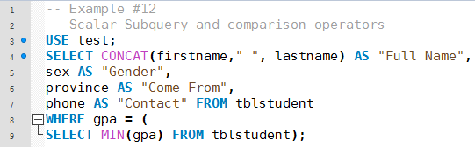

3. Subqueries
Show all students who have smallest gpa
Notes:
SELECT CONCAT(firstname," ",lastname) AS "Student Name",
sex AS "Gender",
province AS "Come From",
phone AS "Contact"
FROM tblstudent
WHERE gpa = (SELECT MIN(gpa) FROM tblstudent);

Slide 29
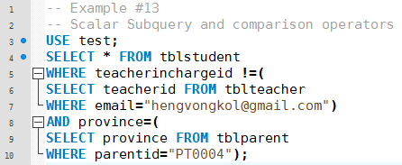
3. Subqueries
Activity:10mn
Could you try to interpret or translate this query into simple meaning? Then test this query.
Notes:
Get all students who don’t have teacher in charged as hengvongkol and have province the same as parented pt00004

Slide 30
Activity:10mn
Use sakila database;
We want to select all films (id, title and length) which its length is greater than average length
We want to select all films (id, title and length) which its length is greater than average length order by its title from Z-A
Notes:
Average length of all film
SELECT AVG(LENGTH) FROM film;
We want to select all films (id, title and length) which its length is greater than average length
SELECT film_id,title, f.length FROM film AS f WHERE f.LENGTH > (SELECT AVG(LENGTH) FROM film);
We want to select all films (id, title and length) which its length is greater than average length order by its title from Z-A
SELECT film_id,title, f.length FROM film AS f WHERE f.LENGTH > (SELECT AVG(LENGTH) FROM film) ORDER BY title DESC;

Slide 31
3. Subqueries
A subquery with IN and NOT IN
it can returns more than one value
Syntax:
operand IN (subquery)
operand NOT IN (subquery)

Slide 32
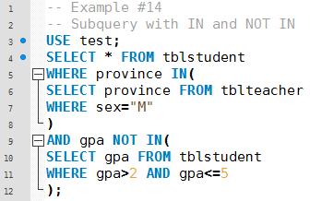
3. Subqueries

Slide 33
3. Subqueries
A subquery with EXISTS and NOT EXISTS
the keyword EXSISTS means ”return true if subquery returns any rows, otherwise false”.
Syntax:
operand where EXISTS | NOT EXISTS (subquery)

Slide 34
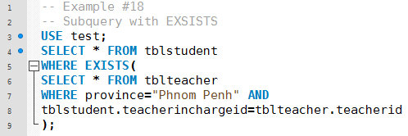
3. Subqueries

Slide 35
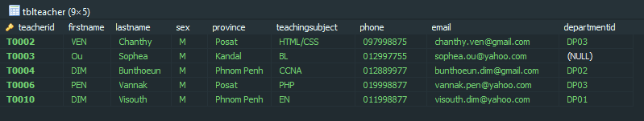
Activity:10mn
Use test
List teachers who don’t have student in charge
Notes:
List teacher don’t have student in charge
#3 select * from tblteacher tea where not exists (select DISTINCT(stu.teacherinchargeid) from tblstudent stu where tea.teacherid = stu.teacherinchargeid);

Slide 36
3. Subqueries
A subquery with ANY and SOME
it can returns more than one value
the ANY keyword means “return TRUE if the comparison is TRUE for ANY of the values in the column that the subquery returns”.
the SOME is an alias of ANY.
Syntax:
operand comparison_operator ANY (subquery)
operand comparison_operator SOME (subquery)

Slide 37
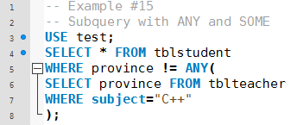
3. Subqueries
Notes:
Return * if province != province of teacher of subject c++

Slide 38
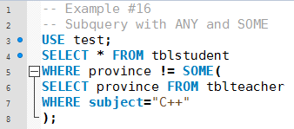
3. Subqueries

Slide 39
3. Subqueries
A subquery with ALL
it can returns more than one value
the keyword ALL means “return TRUE if the comparison is TRUE for ALL of the values in the column that the subquery returns”.
Syntax:
operand comparison_operator ALL (subquery)

Slide 40
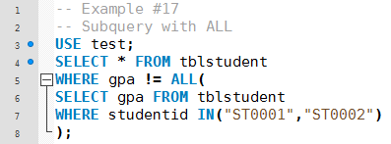
3. Subqueries

Slide 41
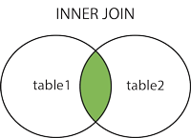
4. INNER JOINS
An inner join or equi-join is used to combines the data from two or more tables.
the values in the columns being joined are compared using a comparison operator.
Table A
Table B

Slide 42
4. INNER JOINS
Common syntax of inner join of two tables:
SELECT table1.col1, table2.col2, [ ….] FROM table1
INNER JOIN table2 ON
table1.col <comparison operator> table2.col;
- An inner join strictly enforces the join condition, any row without a matching row in the other table is dropped from the result.

Slide 43
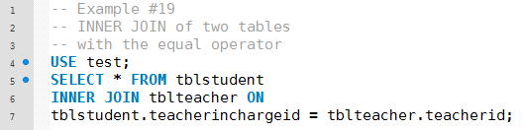
4. INNER JOINS
Notes:
Get all information of the students whose have teacher in charged and also teacher information
SELECT * FROM `tblteacher`, tblstudent WHERE tblteacher.teacherid=tblstudent.teacherinchargeid

Slide 44
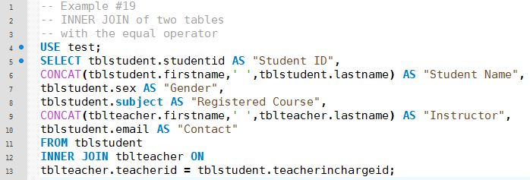
4. INNER JOINS

Slide 45
4. INNER JOINS
Common inner join of two tables can be done by using WHERE clause well:
SELECT table1.col1, table2.col2, [ ….]
FROM table1, table2
WHERE tabl1.foreignkey = table2.primarykey
AND (other conditions)

Slide 46
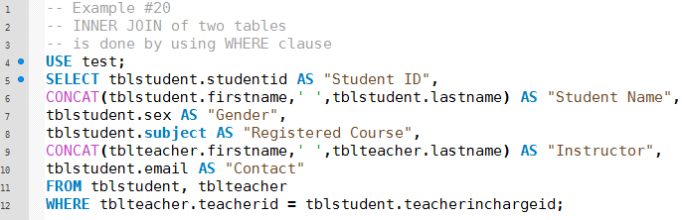
4. INNER JOINS

Slide 47

Activity:10mn
User salika
Show list of films that have category “Animation”
Notes:
USE sakila;
SELECT f.film_id,f.description FROM film f INNER JOIN film_category fc ON f.film_id=fc.film_id
INNER JOIN category c ON c.category_id = fc.category_id WHERE c.NAME = 'Animation'

Slide 48
5. OUTER JOINS
Inner joins return rows only when there is at least one row from both tables that matches the join condition.
Outer joins return all rows from at least one of the tables in the FROM clause, as long as those rows meet WHERE conditions.
There are several types of OUTER JOIN:
LEFT JOIN
RIGHT JOIN
FULL JOIN

Slide 49
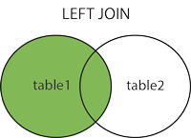
5. OUTER JOINS
The LEFT JOIN:
returns all rows from the left table, even if there are no matches in the right table.
means that if the ON clause matches 0 (zero) records in right table, the join will still return a row in the result, but with NULL in each column from right table.
SELECT table1.col1, table2.col2, [ ….] FROM table1
LEFT JOIN table2 ON
table1.col <comparison operator> table2.col;

Slide 50
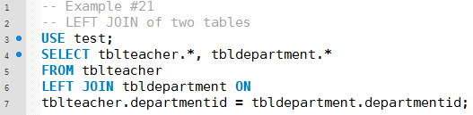
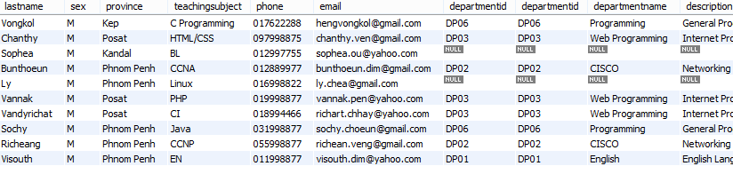
5. OUTER JOINS
Notes:
select * from tblteacher left join tbldepartment ontblteacher.departmentid = tbldepartment.departmentid

Slide 51
Activity:10mn
User salika
Write left join query between film and language in order to know which language aren’t used
Notes:
select * from language left join film on language.language_id = film.language_id

Slide 52
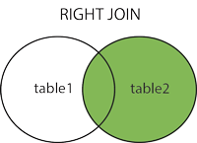
5. OUTER JOINS
The RIGHT JOIN:
returns all rows from the right table, even if there are no matches in the left table.
means that if the ON clause matches 0 (zero) records in left table, the join will still return a row in the result, but with NULL in each column from left table
SELECT table1.col1, table2.col2, [ ….] FROM table1
RIGHT JOIN table2 ON
table1.col <comparison operator> table2.col;

Slide 53
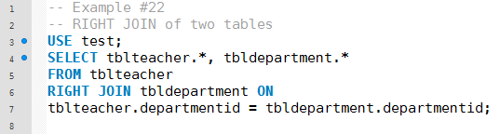
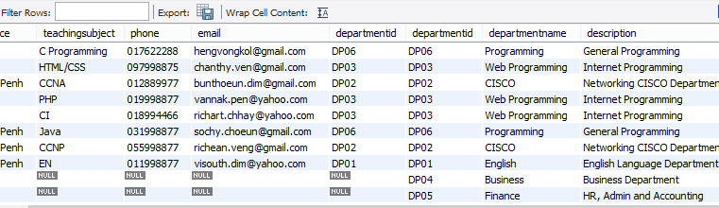
5. OUTER JOINS
Notes:
It means some department may not have any teacher working in

Slide 54
Activity:10mn
Use test
Write right join query in order to know who are the teachers that don’t have any students in charge.
Notes:
select * from tblstudent right join tblteacher on tblteacher.teacherid=tblstudent.teacherinchargeid
Remind them about this solution on slide 35 with not in or exist

Slide 55
5. OUTER JOINS
The FULL JOIN:
combines the results of both left and right outer joins.
The joined table will contain all records from both tables, and fill in NULLs for missing matches on either side.
MySQL does not support FULL JOIN.
SELECT table1.col1, table2.col2, [ ….] FROM table1
FULL JOIN table2 ON
table1.col <comparison operator> table2.col;

Slide 56

Question?
Google.com

